Slide 1

Kaggle 2021 survey report

Slide 2
Research Questions
1- what is the ratio of arabs to non arabs
2- What is the count of all group ages
3- The education degree for all participations
4- what is the genre of participations
5- what is the most commo profession
6-what is the most popular programming language

Slide 3
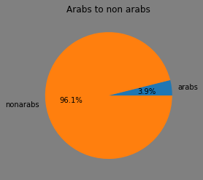
Arabs ratio
We see here that arabs are the minority with 3.9% of all participants

Slide 4
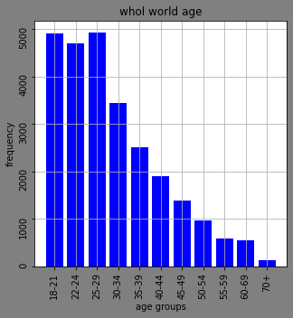
Age groups
Age groups from 25 -29 is the most age group on this website

Slide 5
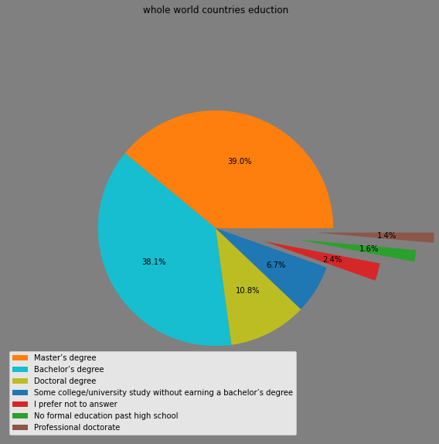
Degree Qualifications
The master’s degree is the most educational degree then comes the bachelor’s degree

Slide 6
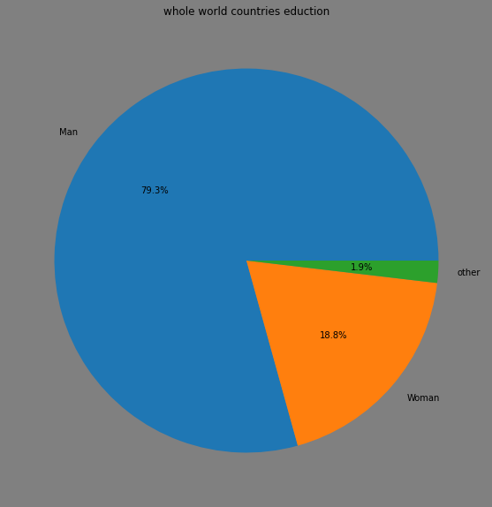
Gender percentage
Males are the dominant gender

Slide 7
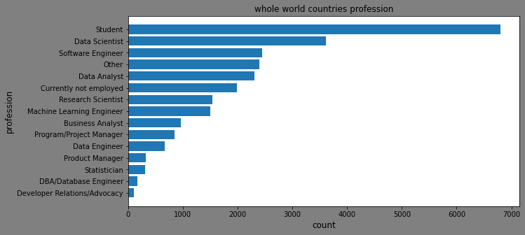
Most common profession
We can see that Most learners on this website are students

Slide 8
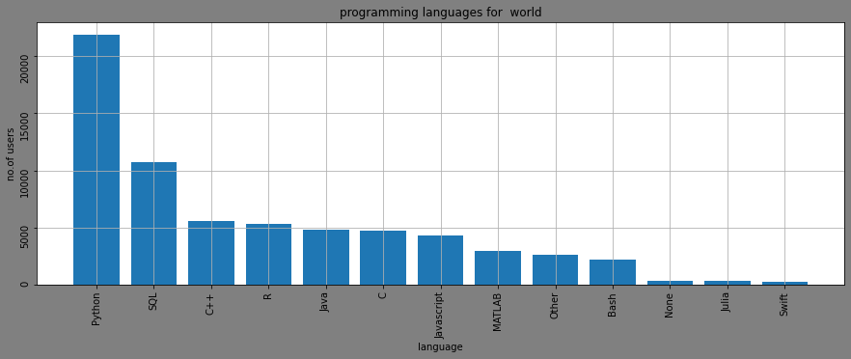
Most popular programming language
Python is dominating this race with more than 20000 users

Slide 9
Conclusion
Men are the most dominant genre
python is the most popular genre
non arabs are considered the majority of the people
student is the dominant profession
the most degree is'Masters degree ' then 'bachelors degree'
the biggest age group is 25-29

Slide 10
Limitations
-This data set dont represent the whole population in the IT world
-This data set for only who replied for the survey it may not represent evey one on kaggle.com

